Slide 1


Slide 2














UPAF Members & Affiliates
Affiliates​
Latino Strings, Wisconsin Conservatory of Music, Kids from Wisconsin, Bembe Drum & Dance, Frankly Music, Milwaukee Jazz Institute, Racine Symphony Orchestra, Festival City Symphony, TBEY, Marcus Performing Arts Center, Milwaukee Opera Theater, Studio K Flamenco, Waukesha Civic Theatre, Above the Clouds, Sharon Lynne Wilson Center for the Arts, Wild Space Dance Company, Milwaukee Youth Theatre​

Slide 3




About UPAF
VISION:​ A thriving Southeastern Wisconsin community, ​unified and uplifted by the performing arts.
MISSION: UPAF advances the vitality of Southeastern Wisconsin by raising essential funds, providing strategic stewardship and inspiring involvement in the performing arts.
WIDE SCOPE OF INVESTMENT
REGIONAL VIBRANCY
ARTS EDUCATION & ACCESSIBILITY
INSPIRING INVOLVEMENT
One Gift.
Regional Impact.
The Arts Power a Strong, Competitive Region.
Every Child. Every Ability. Every Community.
Where Passion Becomes Lifelong Support.
Notes:
One Gift. Regional Impact.
The arts strengthen our workforce and our communities.
They improve quality of life, increase social connection, and help create healthier, more engaged employees.
A single gift through UPAF supports multiple organizations and delivers impact across the entire region.
Regional Vibrancy & Economic Impact
A strong arts scene helps employers attract and retain talent—people want to live and work in culturally vibrant regions.
In Southeastern Wisconsin, arts events generate $142.8 million in related spending on dining, retail, parking, and lodging.
The performing arts sector supports approximately 6,000 local jobs, contributing directly to our regional economy.
Arts Education & Accessibility
Access to the arts helps build the future workforce by fostering creativity, confidence, and collaboration.
We’ll share more about Arts education and accessibility in the slides to come.
Inspiring Involvement
The performing arts bring people together, build connection, and support overall well-being.
Workplace giving allows employees to invest in something meaningful—turning passion into long-term community impact.

Slide 4
Benefits of A United Arts Fund
Raises money for local arts institutions by consolidating fundraising efforts into one organization
Establishes the arts as a civic responsibility important for the common good
Provides accountability and knowledge not feasible for most donors individually
Centralizes funding requests made to local businesses
Recruits and engages leaders and volunteers who span a wide range of sectors for the benefit of the arts
Communities with a united arts fund are better off than those without – the arts sector is larger, arts groups spend less on fundraising and have more stability and total arts spending is higher
(Americans for the Arts)

Slide 5
UPAF’s National Leadership
ArtsFund
UPAF
ArtsWave
Nation’s Largest
Performing Arts Fund
ArtsWave (OH) – $12.5M
Endowment & Public Funds
Arts funded: Museums, theaters, music venues, cultural institutions, individual artists & arts initiatives
United Arts Central Florida
ArtsFund (WA) – $12.5M
Endowment & Public Funds
Arts funded: Dance, music, theater, visual arts, literary arts, and more
United Arts Central Florida – $9-10M
Endowment & Public Funds
Arts funded: Education, cultural festivals, dance, music, theater, and visual arts​
UPAF (WI) – $9-10M
Community-driven (no endowment/public funds)
Dedicated to the performing arts

Slide 6
Our Impact on the Arts in Southeastern WI
$3.52 per capita in funding $0.18 per capita w/o UPAF
$400+ million raised to date
Largest united fund
for the performing arts
Largest annual supporter to 14 groups
Notes:
UPAF is the largest fund in the country dedicated solely to the performing arts.
To date, UPAF has raised more than $400 million for the local performing arts sector.
This makes UPAF the single largest supporter of performing arts organizations in our region.
What makes this so significant…
Public funding for the arts in Wisconsin ranks at the very bottom nationally, at just $0.18 per capita.
When UPAF’s 2024 funding is added, we jump to $3.70 per capita, placing us in the top 10 nationally
UPAF fills a critical gap, providing essential investment that would not otherwise exist.

Slide 7
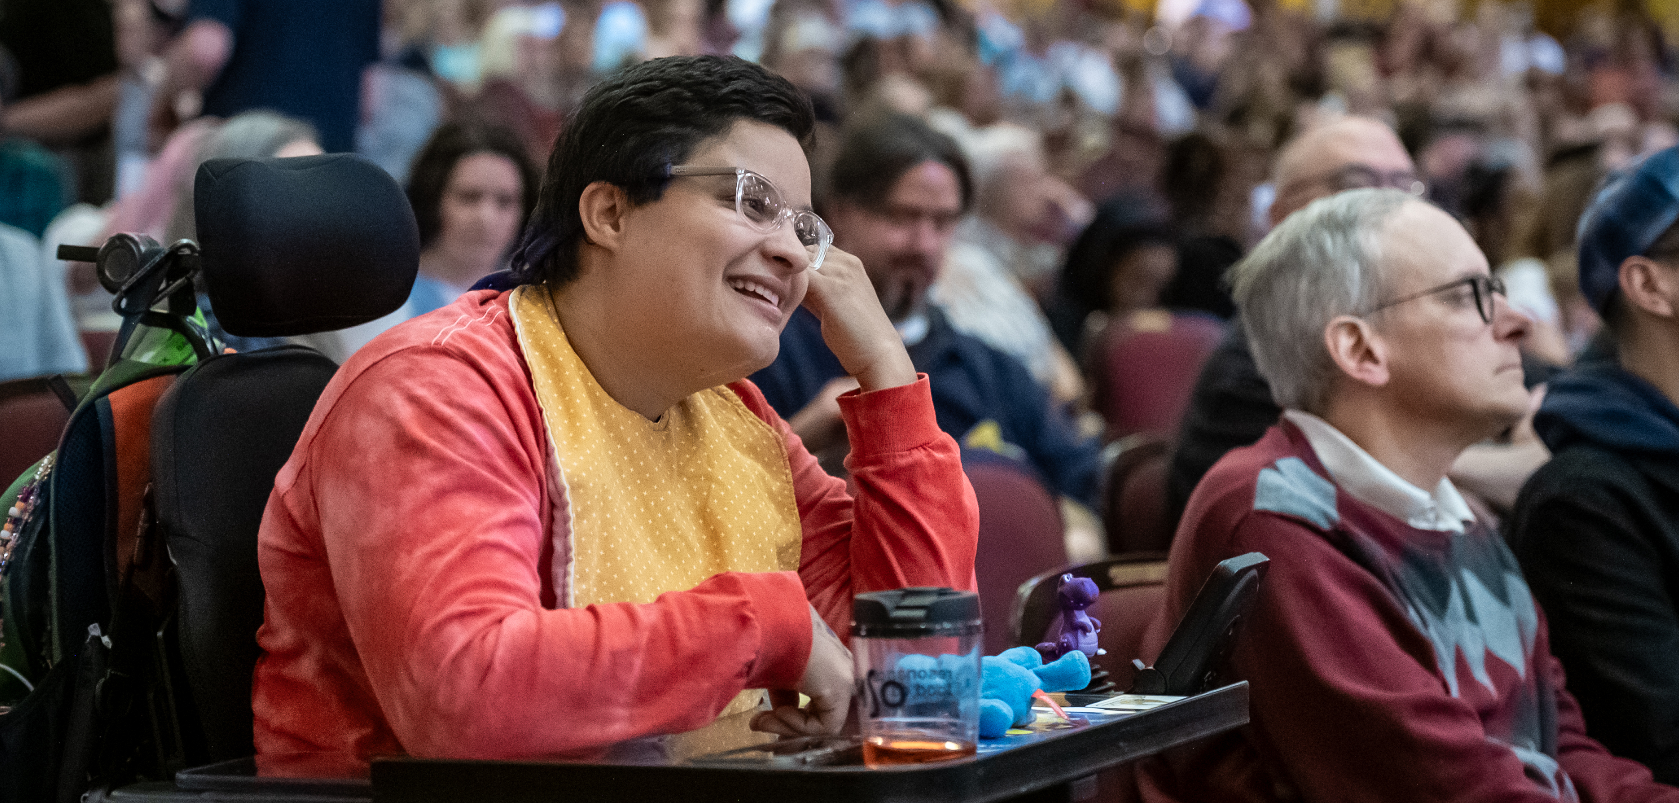

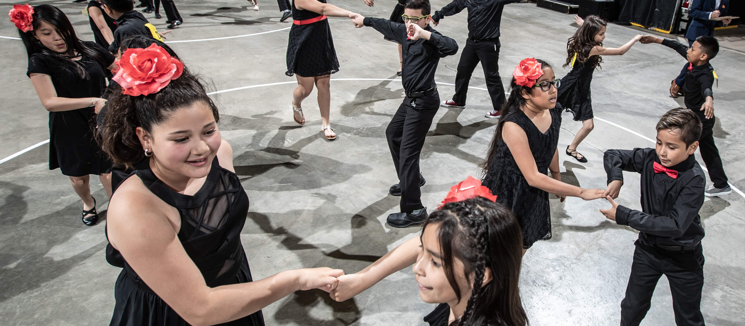

UPAF Community Impact Programs
Created to ensure the accessibility of the arts by eliminating barriers imposed by disability, special needs, and geography.
12 of 14 Members offer ASL, Closed Caption & Sensory Friendly performances.
52,129 free tickets offered to performances and community events.
Directs funds to UPAF Member education initiatives delivering high-quality arts education programs.
Nearly 1,000 Schools Served – Public, Private and Charter.
Over 100,000 K-12 students served.
Notes:
Arts Access:
12 of 14 Members offer ASL, Closed Caption & Sensory Friendly performances.
Over 800 performances and activities annually are FREE to the public
Over 4,000 individuals are served by tailored programming both in the theater and brought to schools, senior centers and assisted-living facilities.
Arts Education:
UPAF's commitment to arts education goes far beyond teaching skills or fostering creativity; it's a commitment to ensuring all children in our community, regardless of race, geography or socio-economic status, can discover who they are through artistic self expression, a commitment to illuminating career opportunities in the arts, and to providing essential social-emotional support to our community.
Nearly 1,000 Schools Served – Public, Private and Charter
Over 100,000 K-12 Students Engaged
Over 100 Zip Codes Reached, including 26 schools in Milwaukee’s most underserved zip codes – 53205, 53206, 53212
651 Scholarships Granted, over a $700,000 value in FREE arts education
75% of Students Served are economically disadvantaged
15% of Students Served are English Language Learners
Arts Education Stats:
Higher GPAs and SAT scores
4x more likely to be recognized for academic achievement
3x more likely to pursue a bachelor's degree
5x less likely to drop out of school
Low-income students are 2x more likely to graduate from college than peers without arts education
In early childhood (ages 3-5) participation in the arts has led to improved IQ, spatial cognition and numeracy.
Arts education experiences reduce the proportion of students in school receiving disciplinary infractions by 3.6%.

Slide 8
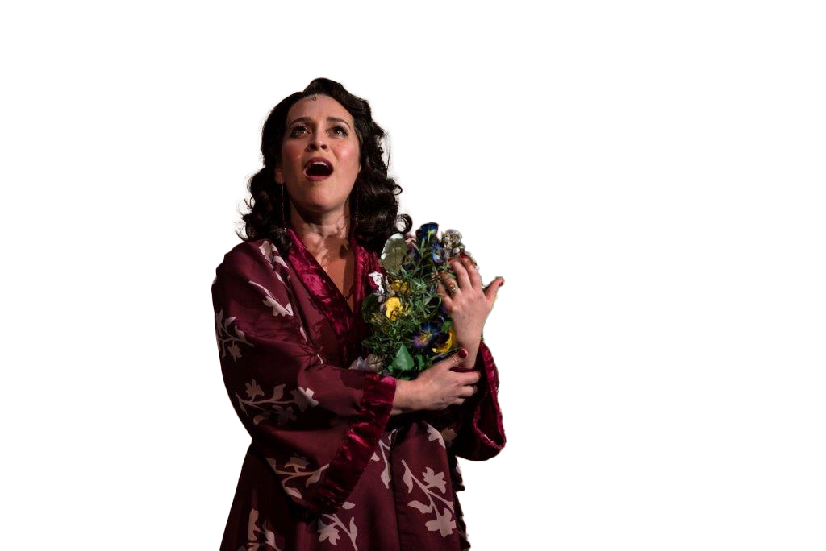
2026 Community Campaign
Goal: $9.5 Million
Our city and region are on a trajectory of growth, with a promising future ahead. Downtown is witnessing the relocation of major businesses, while high-rise cranes dominate the skyline as they construct hotels, apartments, and condominiums. We must recognize the significance of performing arts in shaping our future is crucial for us to ensure that our arts sector thrives and remains inclusive, welcoming everyone.
WELCOME EVERYONE
Promote participation… make the ask!
Inspire involvement.
CREATE AFFINITY
Share stories and impact.
Involve your committee and Executive Leads.
Host special events – leadership, emerging leaders and within ERGs/BRGs.
VISIBILITY
Communicate your goals, events, incentives and deadline!
Notes:
Make the ask to give, make the ask to attend… create a culture where it’s important to attend special events and learn more about the community
Share stories – It becomes fun to learn who played the viola in third grade or has a secret musical talent
There’s so much impact when leaders share things personally, it again fosters this warm culture and community

Slide 9
Committee Role
Workplace Giving helps drive
a third of UPAF’s annual support.
Be a leader. Partner with fellow committee members and UPAF to promote and deliver a successful workplace campaign.
Activate your team and workplace.
Inspiring employee giving and involvement.
Make the impact visible. Help share the story of the performing arts, support communications and engagement, thank donors and volunteers.
Learn & Grow. Gain recognition, career-building skills, valuable connections,
and deeper arts impact expertise.
We are deeply grateful for your time, energy, and passion!

Slide 10
Amazing benefits with a gift to the 2026 UPAF Community Campaign!
CREW $75+
Free Performance Voucher, Local Dining Discounts & Pop-up Offers on Performances!
CORPS $150+
The UPAF SMART CARD: Buy One, Get One FREE Ticket Offers at all 14 UPAF Members
CAST $350+
DOUBLE Your SMART CARD Offers
PRINCIPAL $600+
Access to our exclusive Open Rehearsal Experiences

Slide 11
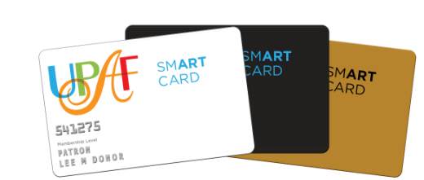
Promote UPAF SMART CARD
The UPAF SMART CARD
is an excellent selling tool to engage
employees in the arts.
Antiqua ASH Bacchus Lake Park Bistro Blue Bat Bravo! The Bridgewater Modern Grill Carnevor Casablanca Harbor House I.d. Joey Gerard’s Mason Street Grill McBob’s Pub & Grill Milwaukee Chop House Milwaukee Magazine Mr. B’s Steakhouse Onesto Pizza Man Proof Pizza Ristorante Bartolotta Riverside Brewery & Restaurant Safe House Saz’s Smoke Shack Stella Van Buren Taylor’s People’s Park The Edison Timmer’s Resort Zarletti
With a donation of $150 or more, SMART CARD holders receive the following benefits:
  “Buy One, Get One Free” tickets to one performance for each of UPAF’s 14 Members, a $750 value!
  Discounts at more than 30 popular area restaurants and businesses

Slide 12
Our Leadership Societies Celebrate our most Generous Supporters!
Director $1,200+
Designate 10% of your gift & be recognized in our Annual Impact Report
Conductor $3,000+
Join us for UPAF Nights, featuring dinner & a show
Concertmaster $5,000+
Designate 20% of your gift
Artist Society $10,000+
Join us for the Artist Society Party, a special celebration of our most generous arts champions

Slide 13
UPAF Give & Win Sweepstakes Prizes for New and Increased Gifts!
$150 or more
Suite for 12 to a Milwaukee Brewers game including parking, food, and beverages
$75 or more
12 tickets to the Milwaukee Brewers Legends Club
$50 or more
Northwestern Mutual Tour + lunch
A one-night Grand Geneva resort package with dining and golf certificates
Four tickets to a Green Bay Packers game
A One Night VIP Staycation including a hotel and dining package, tickets to a Milwaukee Rep performance, and car service
A Season Subscription for 2 to the Milwaukee Symphony
Four tickets to a Milwaukee Brewers Game
Four ticket vouchers to a UPAF Cornerstone Group
Four Milwaukee Brewers tickets to the US Bank Founders Suite - including parking, food, and beverages
Notes:
Colleen

Slide 14
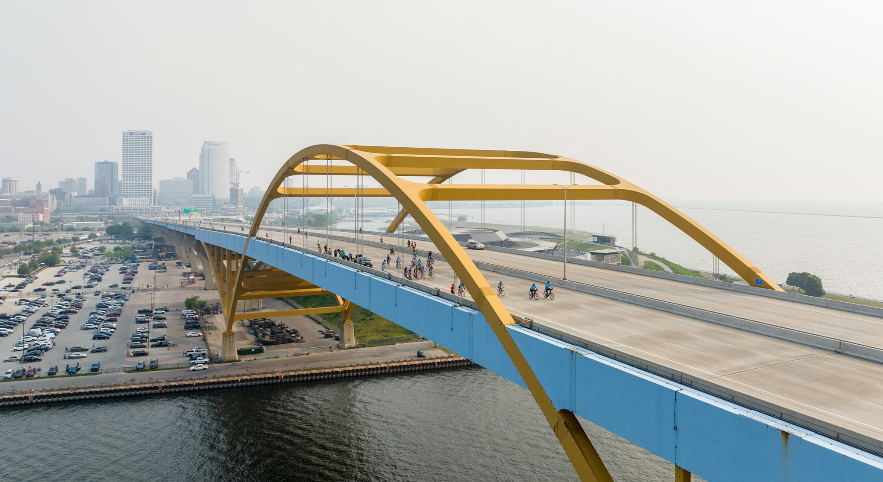
UPAF Ride for the Arts, presented by Miller Lite
Join us Sunday, May 31, 2026
Ride the signature Hoan Loop Course: suited for all ages and abilities, it’s a one‑of-a-kind ride
Enjoy UPAF Fest, featuring live performances, activities for kids, food, drinks & more
Register today at
UPAFRide.org
Notes:
Join us – Sunday, May 31 - UPAF Ride for the Arts, presented by Miller Lite, is a signature community event celebrating Southeastern Wisconsin’s vibrant performing arts scene.
This beloved Milwaukee tradition is an annual fundraiser for the United Performing Arts Fund, engaging thousands of riders and hundreds of volunteers each year. Over its 45-year history, the Ride has raised more than $11 million to support local performing arts organizations.
The 2026 Ride features a fully closed, scenic course—including a rare, one-of-a-kind ride across the iconic Hoan Bridge. With multiple distance options, the Ride is designed for all ages and abilities. It’s the only opportunity to bike over the Hoan without being in a race.
The Ride culminates at Henry Maier Festival Park with UPAF Fest, a free, community-wide celebration showcasing our members’ world-class talent. From activities to, food, and beverages—there’s truly something for everyone. Not a cyclist? You can still join the fun and celebrate alongside your Ride team.
The Ride takes place at the end of the workplace giving season, making it a perfect opportunity to bring teams together and celebrate the impact they’ve made. Companies may choose to subsidize registrations or offer discounts. Sponsorship opportunities are also available, including engagement tables to promote your organization or serve as a team gathering space.

Slide 15
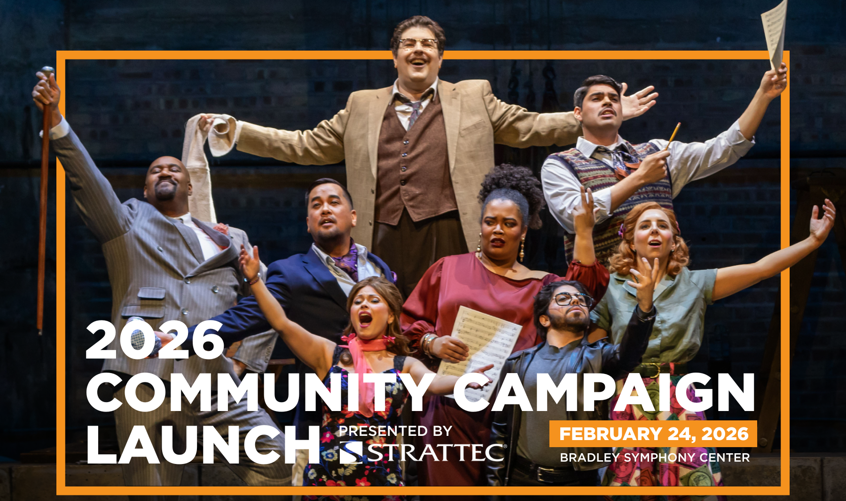
Upcoming Events
January/February
January/February
February – May 31
2026
2026
Workplace Giving Campaigns & Donor events
Various Locations
April
April/May
May
June
2026
2026
31
2026
Notable Women Event
Brewers Stadium
Visionaries in the Arts Luncheon
Saint Kate’s – The Arts Hotel
Ride for the Arts
Summerfest
UPAF Presents: Symphonic Sunset TBD

Slide 16
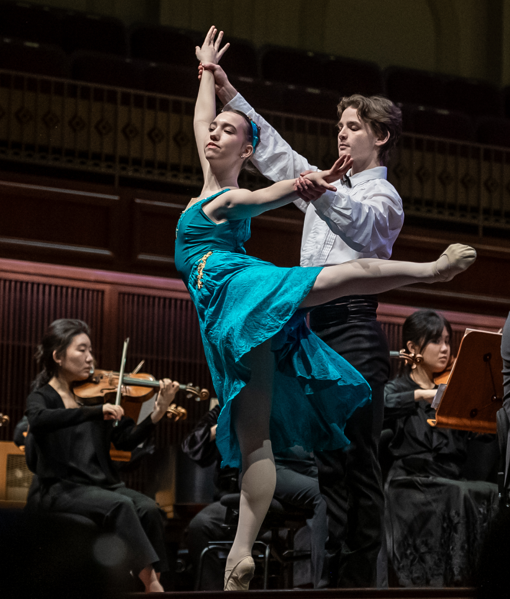
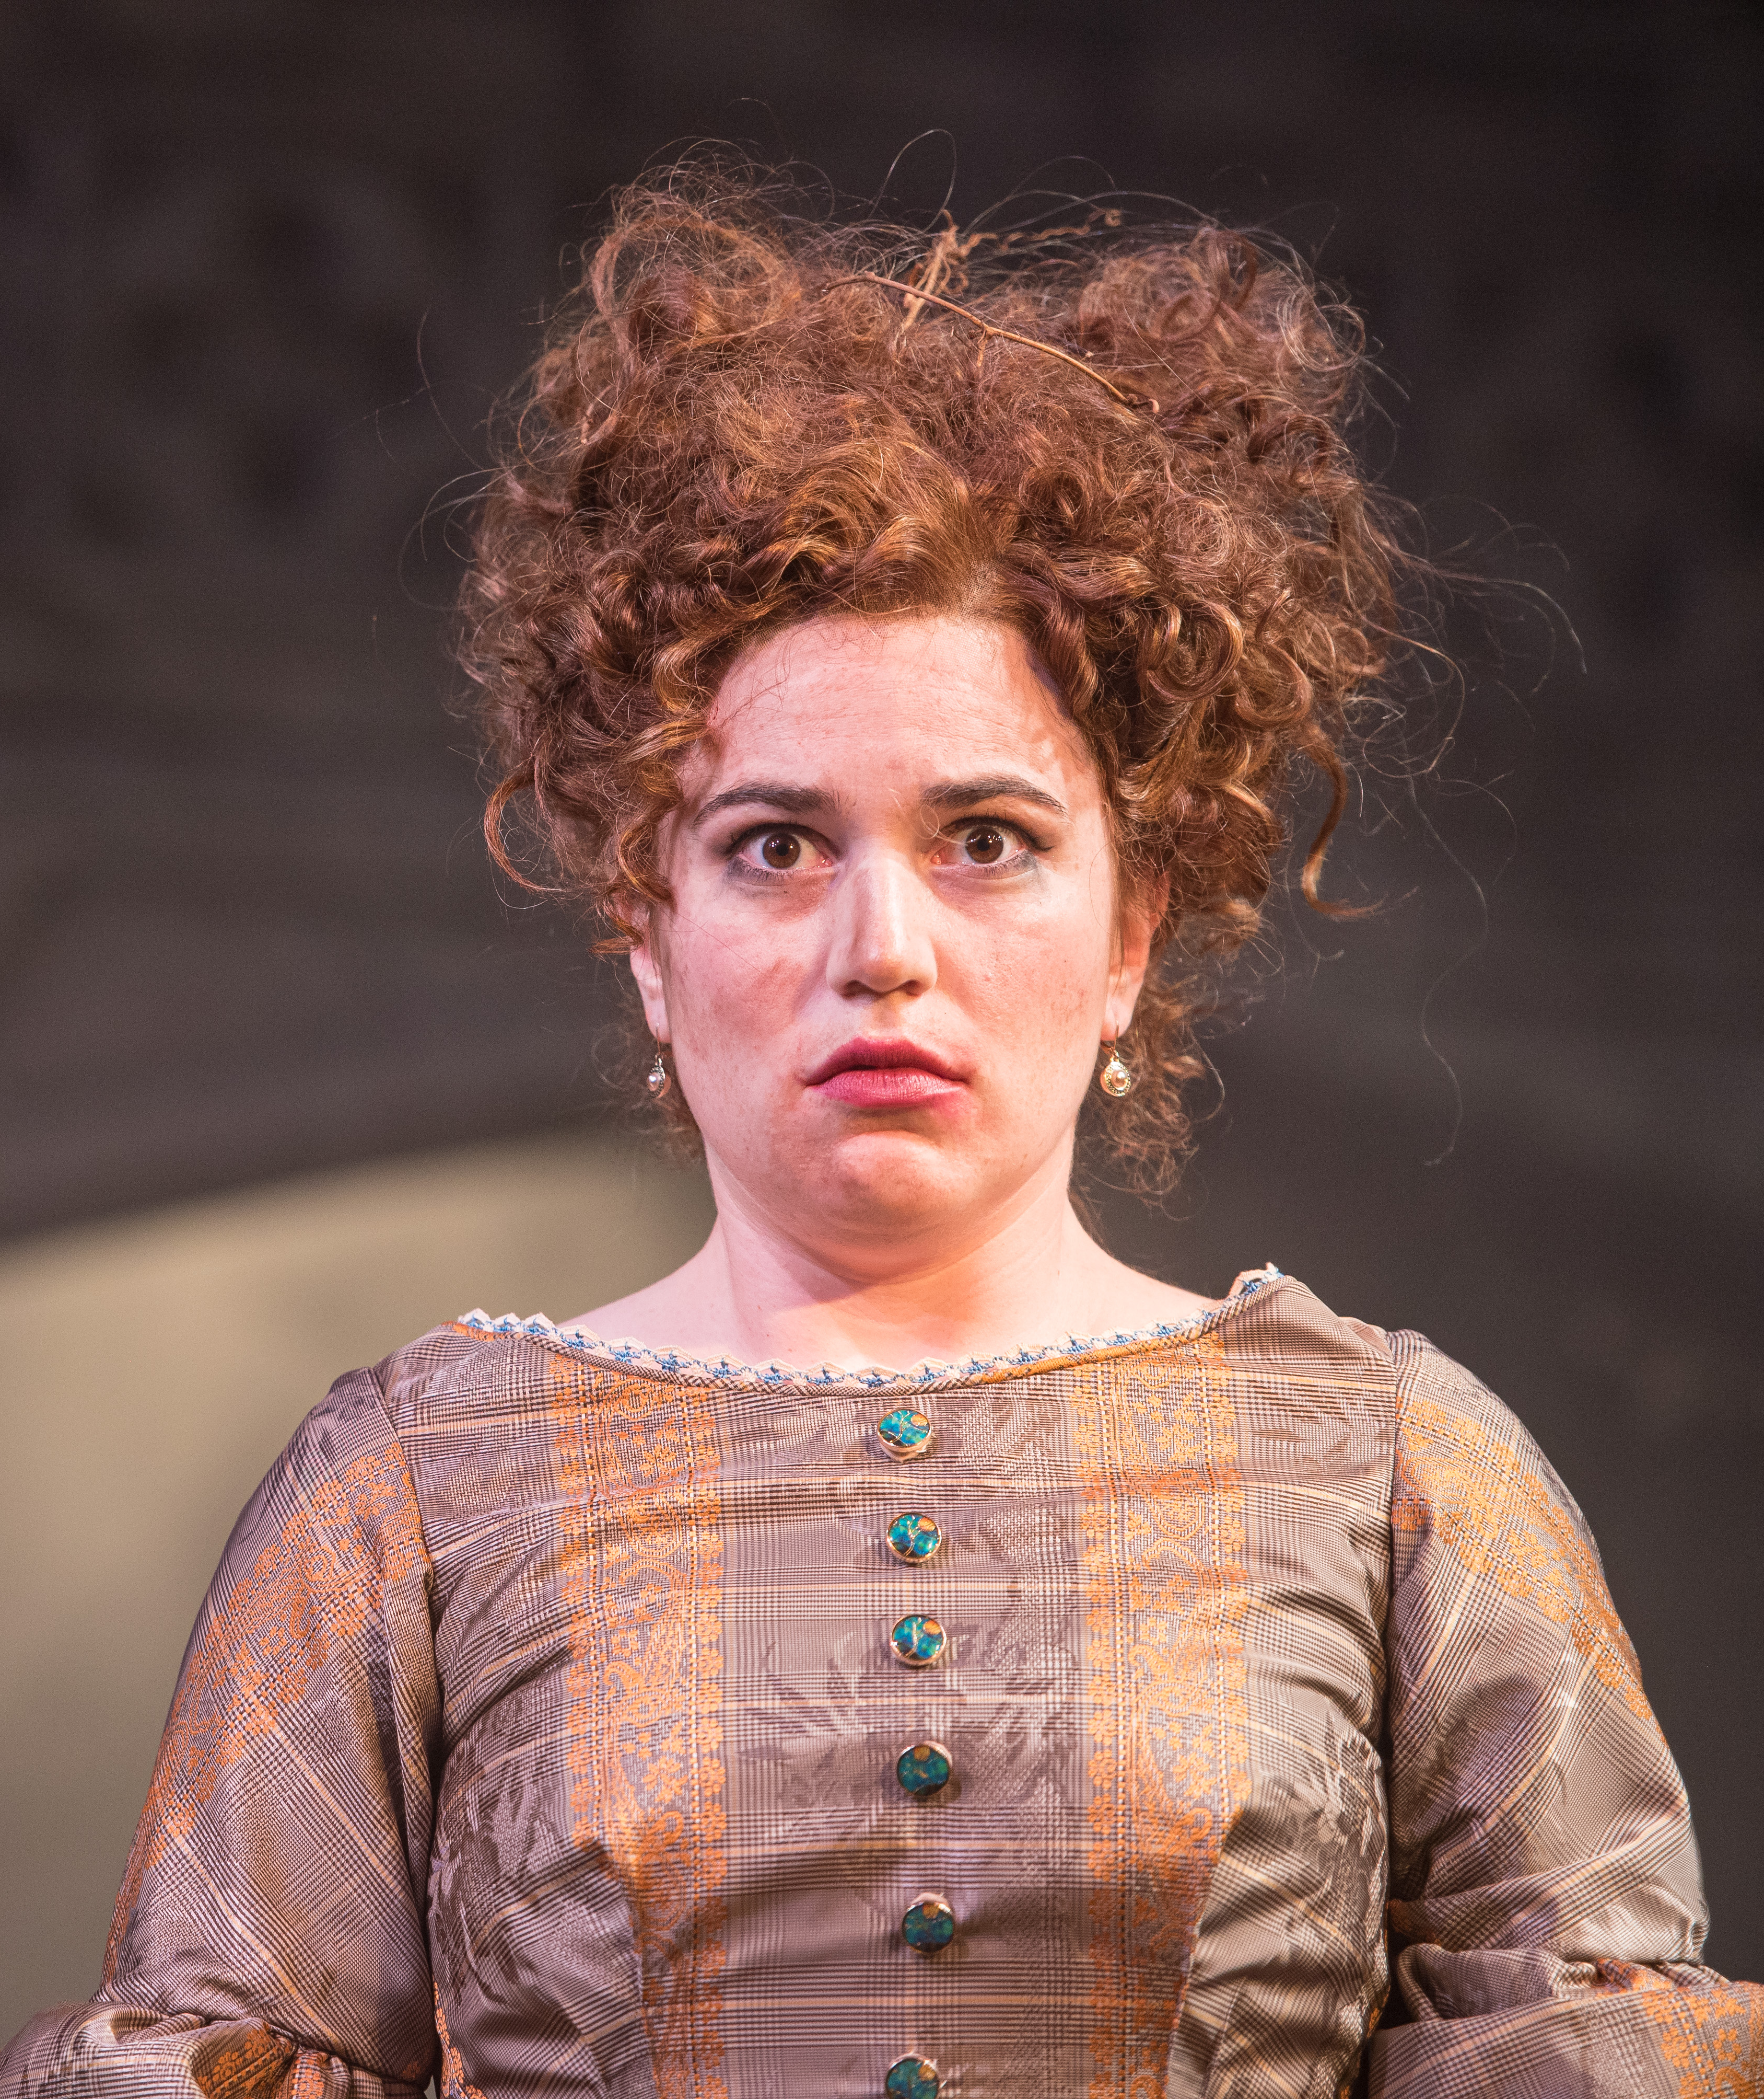
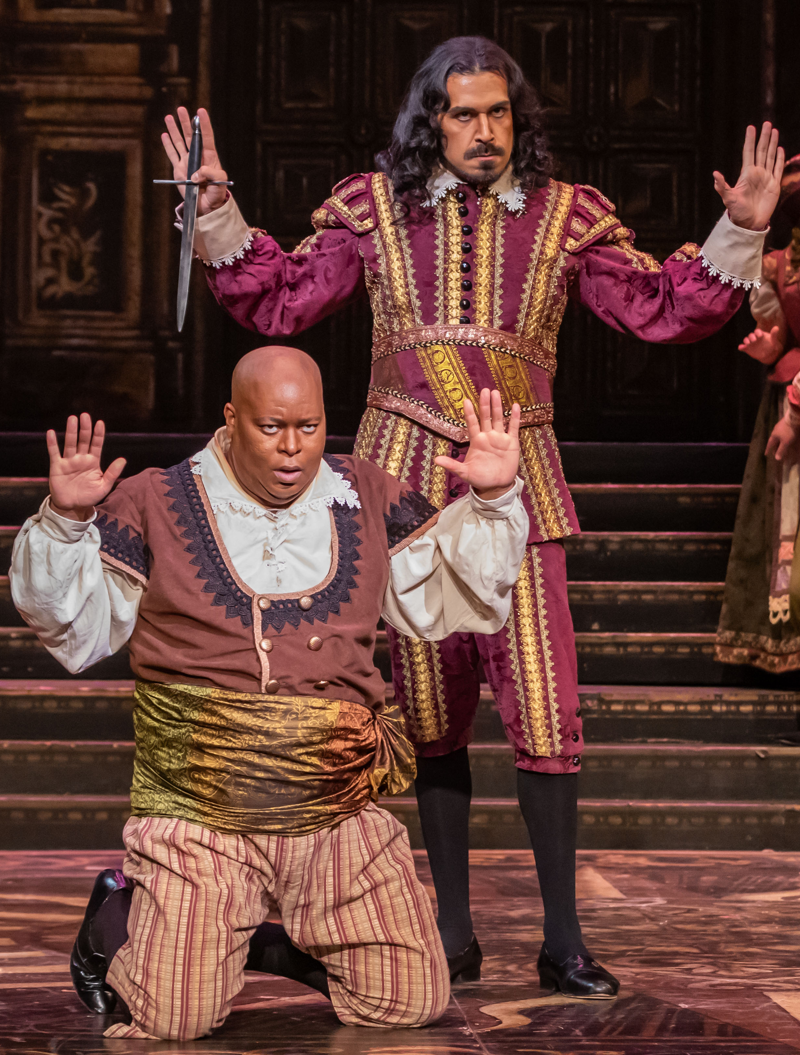
THANK YOU!!!

