Slide 1
Welcome to the 2025 UPAF Campaign Launch!

Slide 2
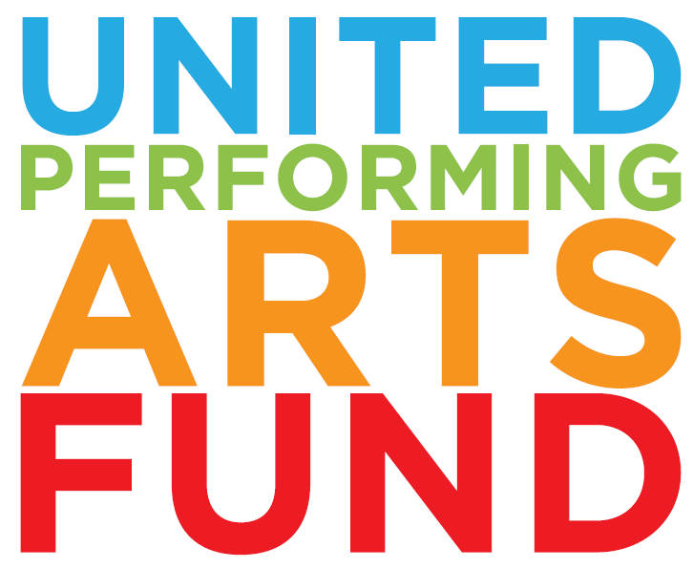
A community investment in the performing arts since 1967
$388M raised over 58 years and growing
The largest annual supporter to our 14 Members, ranging from $60,000-$1,200,000+
Uplifting a vibrant arts ecosystem through annual grants for Affiliates ranging from $1,000-$16,000 – over $3.6M in grants awarded to Affiliates since 2000
Ensuring everyone has access to the transformative power of the performing arts through impact funds for arts education and accessibility

Slide 3
Our Impact on the Arts in Southeastern WI
$3.52 per capita funding in 2024
$388+ million raised to date
Largest united fund
for the performing arts
Largest annual supporter to 14 groups

Slide 4
UPAF Member Groups

Slide 5
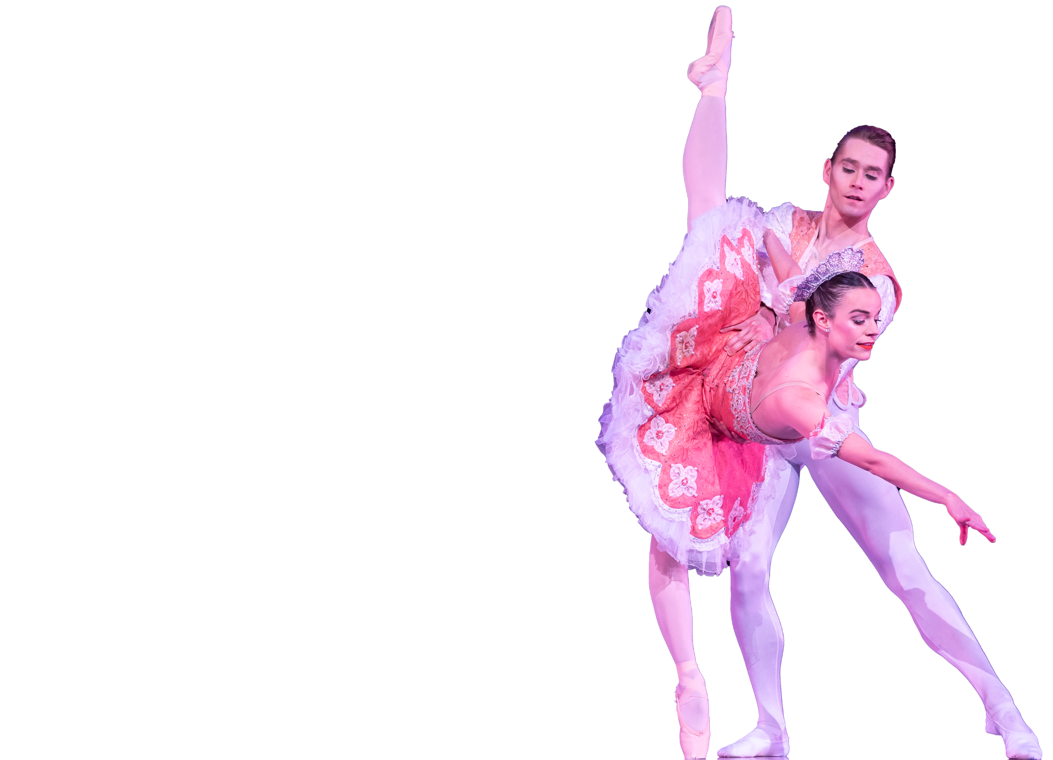
2024 by the Numbers
TOTAL DOLLAR AMOUNT RAISED DURING 2024 CAMPAIGN
TOTAL NUMBER OF DONORS
TO THE 2024 CAMPAIGN
$9,217,213
12,286
TOTAL DOLLAR AMOUNT ALLOCATED
NUMBER OF WORKPLACE GIVING CAMPAIGNS
$7,109,000
109
NUMBER OF
COMPANY DONORS
TO MEMBERS
131
$6,893,225
TO AFFILIATES
With one gift, UPAF donors support dozens of arts organizations throughout Southeastern Wisconsin
$215,775

Slide 6
UPAF’s Vision & Mission
Our vision:
Shaping a diverse, vibrant and sustainable cultural life for all.
Our three-part mission is to:
Raise much-needed funds to ensure entertainment excellence
Promote the performing arts as a regional asset
Responsibly steward the dollars our donors so generously give us

Slide 7
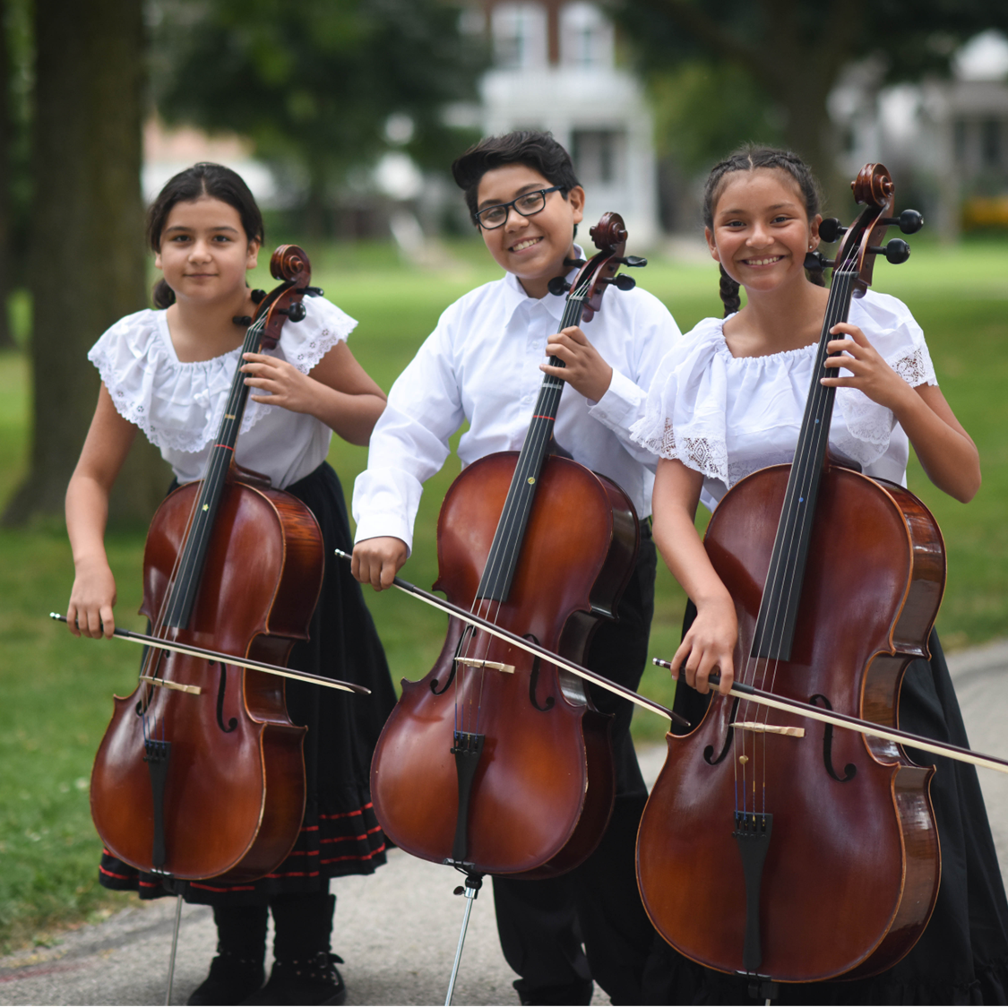
WHY:
The arts make us whole-- physically, mentally, spiritually.
Economic vibrancy. The arts allow businesses to attract and retain talent; they drive revenue for related businesses.
Arts education is crucial for children's academic and social/emotional development.

Slide 8
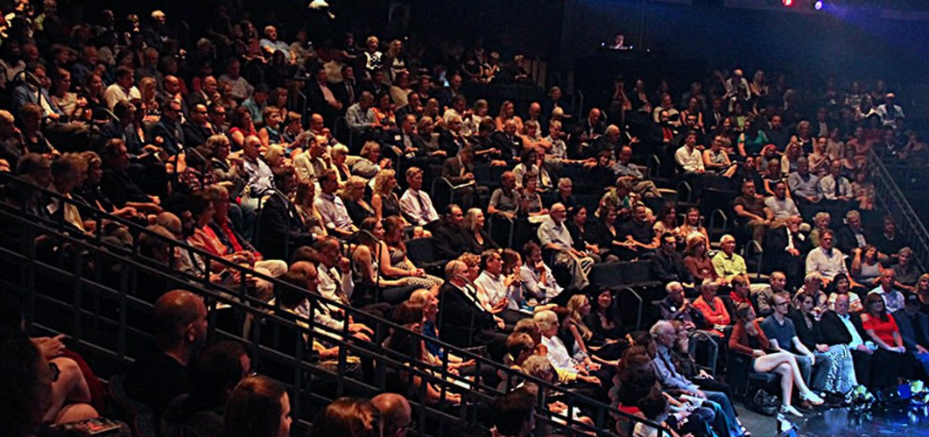
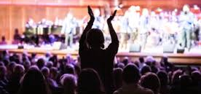
Promoting Regional Vibrancy
The local arts and culture sector generates $334.6 million in economic activity annually
An additional $142.8 million is generated in event-related spending annually
Residents, visitors and talent recruits for local companies are drawn to a region with a vibrant cultural and entertainment scene
While Wisconsin’s public arts funding ranks among the lowest in the country, UPAF fills a critical need for the community

Slide 9
Fueling the Community through UPAF Community Impact Programs
Directs funds to UPAF Member education initiatives, delivering high-quality arts education programs that prepare students with the tools to be successful in work and life.
Ensures the accessibility of the arts by eliminating barriers imposed by disability, special needs, geography
and other physical and mental considerations.

Slide 10
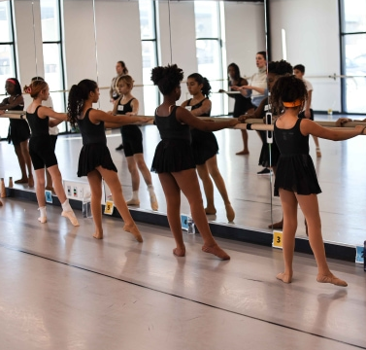
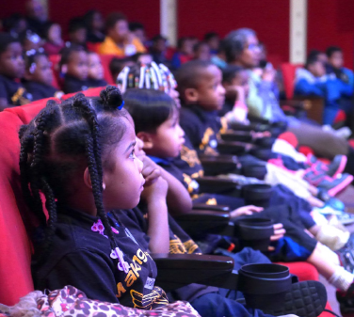
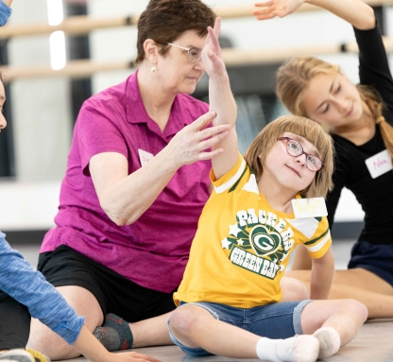
Our Impact on Arts Education and Access
Arts Education:
Arts Accessibility:
12 of 14 Members offer ASL, Closed Caption & Sensory Friendly performances.
800 activities are FREE to the public
4,000 served both in the theater and brought to schools, senior centers and assisted-living facilities.
130,000 K-12 students
served annually
1,000 Schools Served
100 Zip Codes Reached, including 26 in Milwaukee’s most underserved zip codes
651 Scholarships Granted, totaling over a $700,000
75% Served are economically disadvantaged
Served 2x as many individuals in 2024 vs. 23

Slide 11
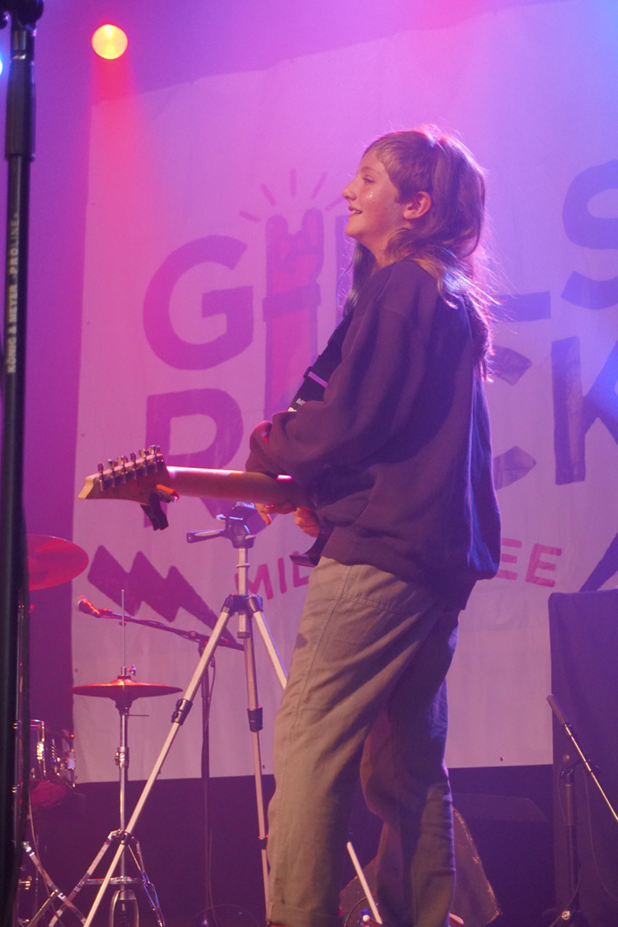
Committed to Arts Education
UPAF’s 14 Members and numerous Affiliate organizations provide impactful arts education to our region’s youth, empowering them to discover who they are and who they want to be through creative expression.
Arts Education Stats:
Higher GPAs and SAT scores
4x more likely to be recognized for academic achievement
3x more likely to pursue a bachelor's degree
5x less likely to drop out of school
Low-income students are 2x more likely to graduate from college than peers without arts education
In early childhood (ages 3-5) participation in the arts has led to improved IQ, spatial cognition and numeracy.
Arts education experiences reduce the proportion of students in school receiving disciplinary infractions by 3.6%

Slide 12
Enjoy the best in live, local entertainment with your gift to the 2025 UPAF Community Campaign!
CREW $75+
Free Performance Voucher, Local Dining Discounts & Pop-up Offers on Performances!
CORPS $150+
The UPAF SMART CARD: Buy One, Get One FREE Ticket Offers at all 14 UPAF Members
CAST $350+
DOUBLE Your SMART CARD Offers
PRINCIPAL $600+
Access to our exclusive Open Rehearsal Experiences

Slide 13
Our Leadership Societies Celebrate our most Generous Supporters
Director $1,200+
Designate 10% of your gift & be recognized in our Annual Impact Report
Conductor $3,000+
Join us for UPAF Nights, featuring dinner & a show
Concertmaster $5,000+
Designate 20% of your gift
Artist Society $10,000+
Join us for the Artist Society Party, a special celebration of our most generous arts champions

Slide 14
UPAF Give & Win Sweepstakes Prizes for New and Increased Gifts!
$150 or more
Backstage dinner for 10 at the Miller High Life Theater
Four tickets to the U.S. Bank Founders Suite at a Milwaukee Brewers game
Milwaukee Symphony Orchestra tickets & a tour
$75 or more
Grand Geneva prize package
Four tickets to a Green Bay Packers game
Four premium tickets to Milwaukee Brewers game
Tickets & a backstage tour at Skylight Music Theatre
$50 or more
PNC Major League Moment Package
Danceworks Subscription
Four tickets to your choice of Milwaukee Ballet’s Nutcracker or the Rep’s A Christmas Carol
Four UPAF performance vouchers

Slide 15
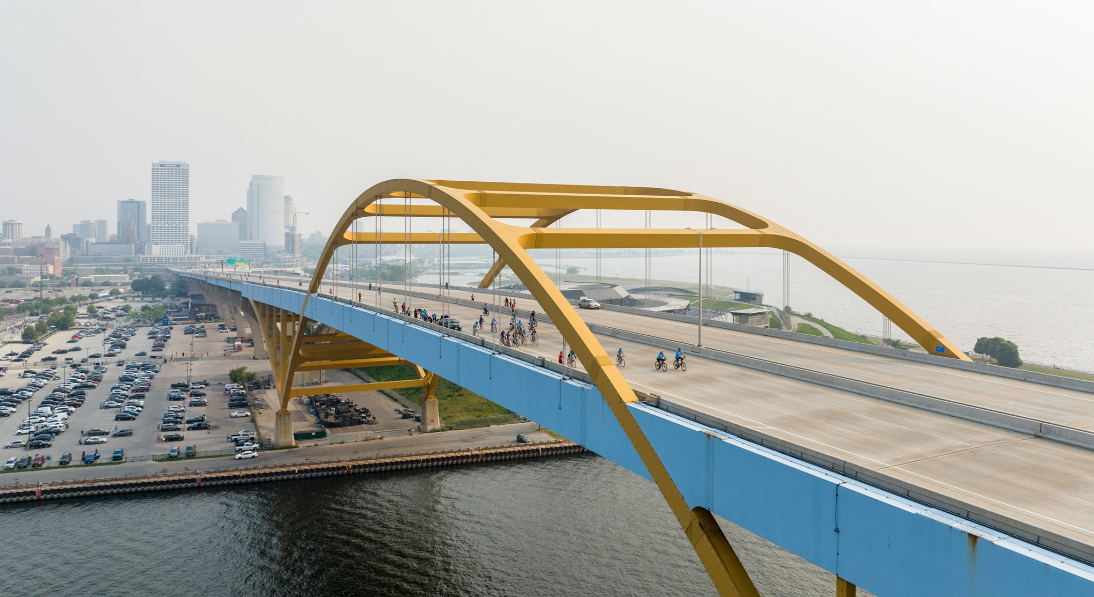
UPAF Ride for the Arts, presented by Miller Lite
Join us Sunday, June 1, 2025
It’s our 45th Anniversary!
Our signature Hoan Loop Course is back: suited for all ages and abilities, it’s a one‑of-a-kind ride
Enjoy UPAF Fest, featuring live performances, activities for kids, food, drinks & more
Register today at
UPAFRide.org
Notes:
It’s the 45th Anniversary of the UPAF Ride for the Arts

Slide 16
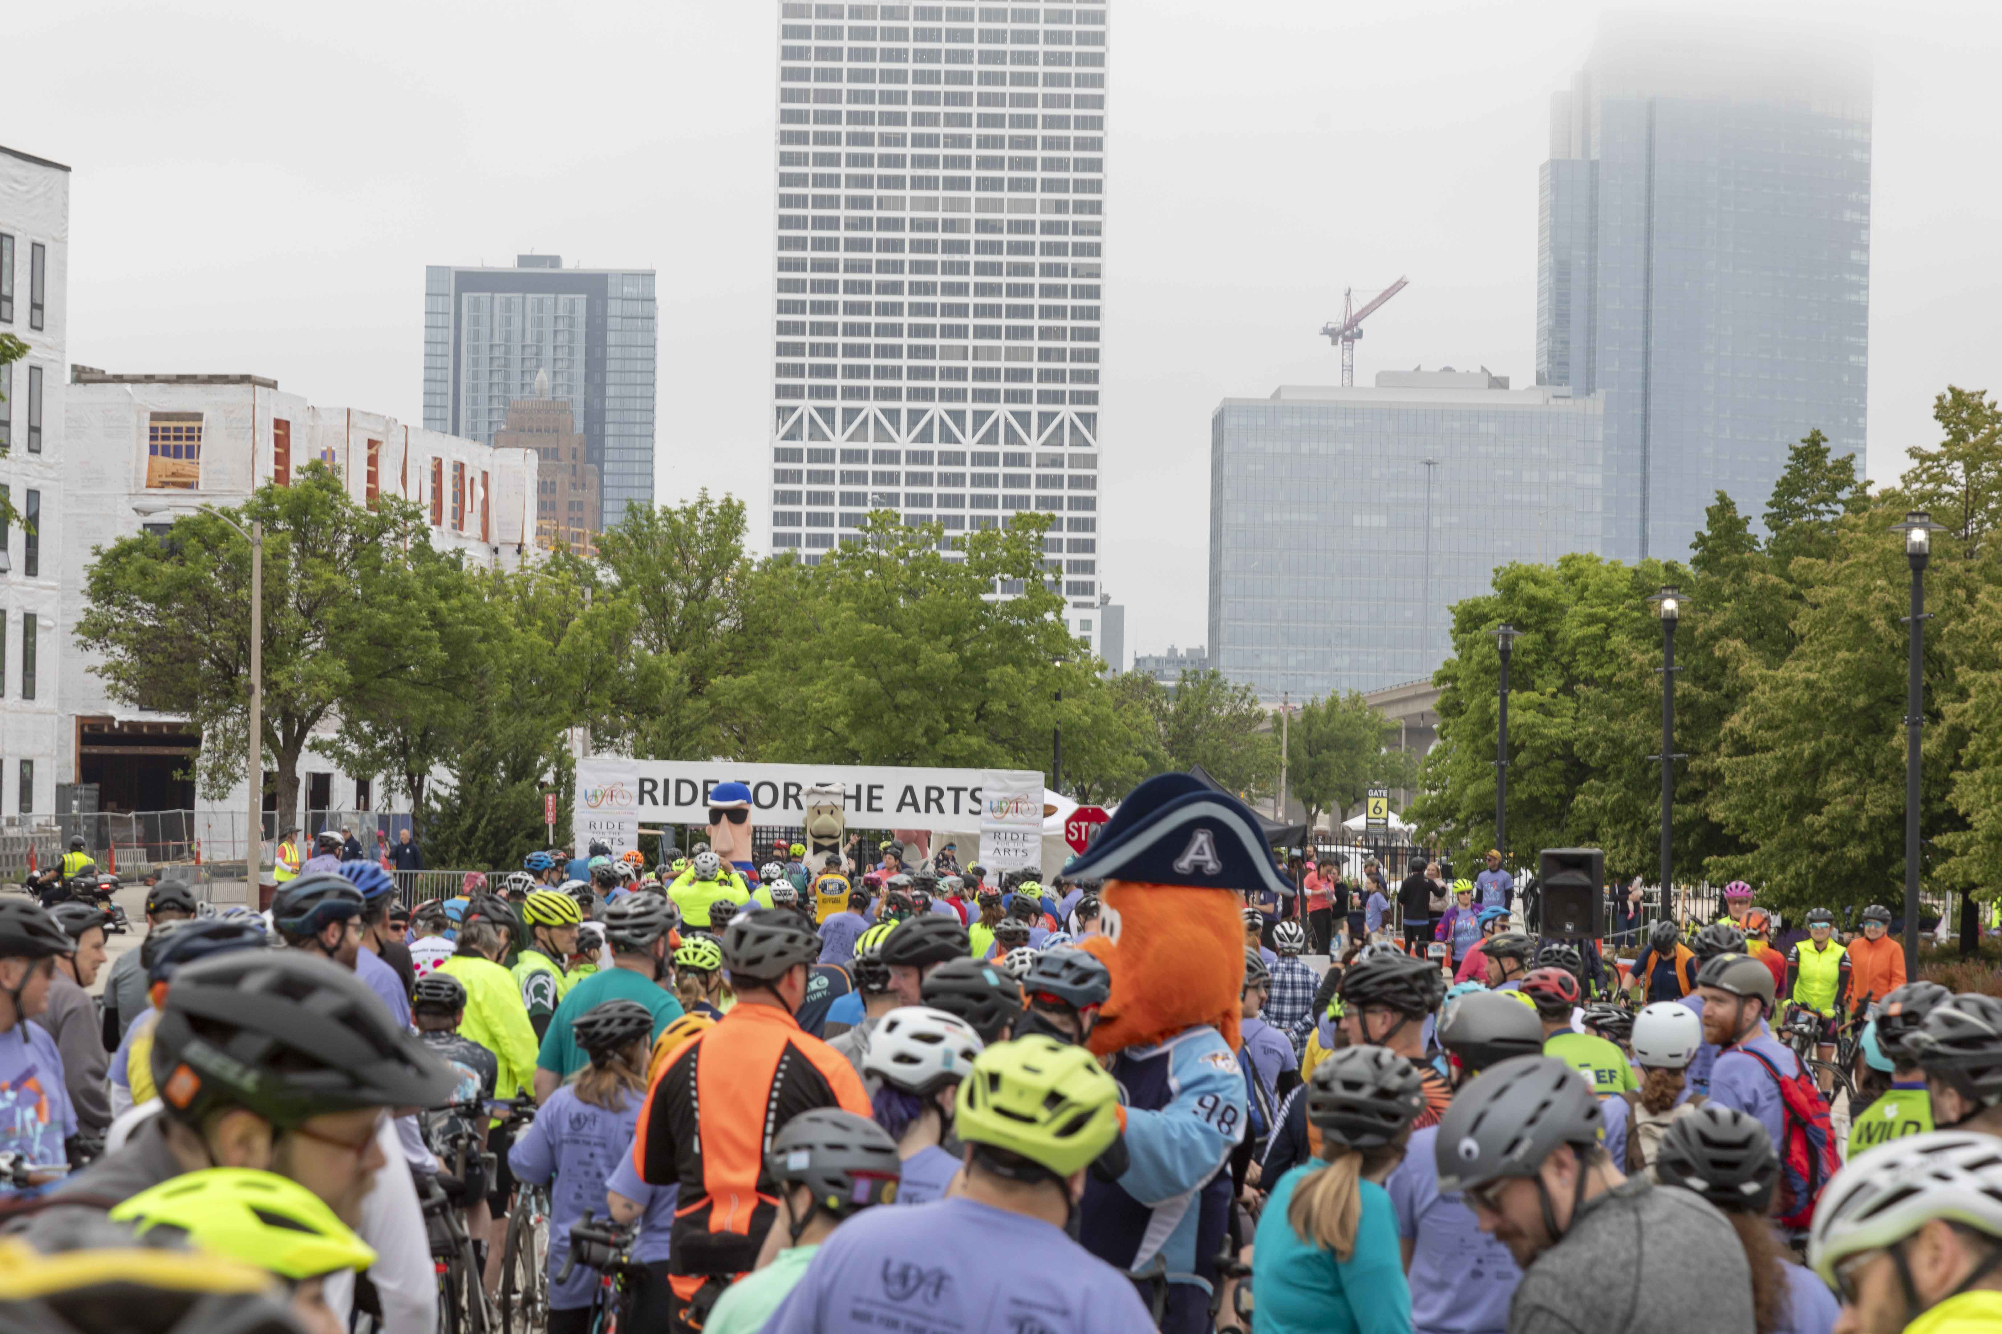
2025 is the 45th ANNIVERSARY
UPAF Ride for the Arts, Presented by Miller Lite June 1, 2025

Slide 17
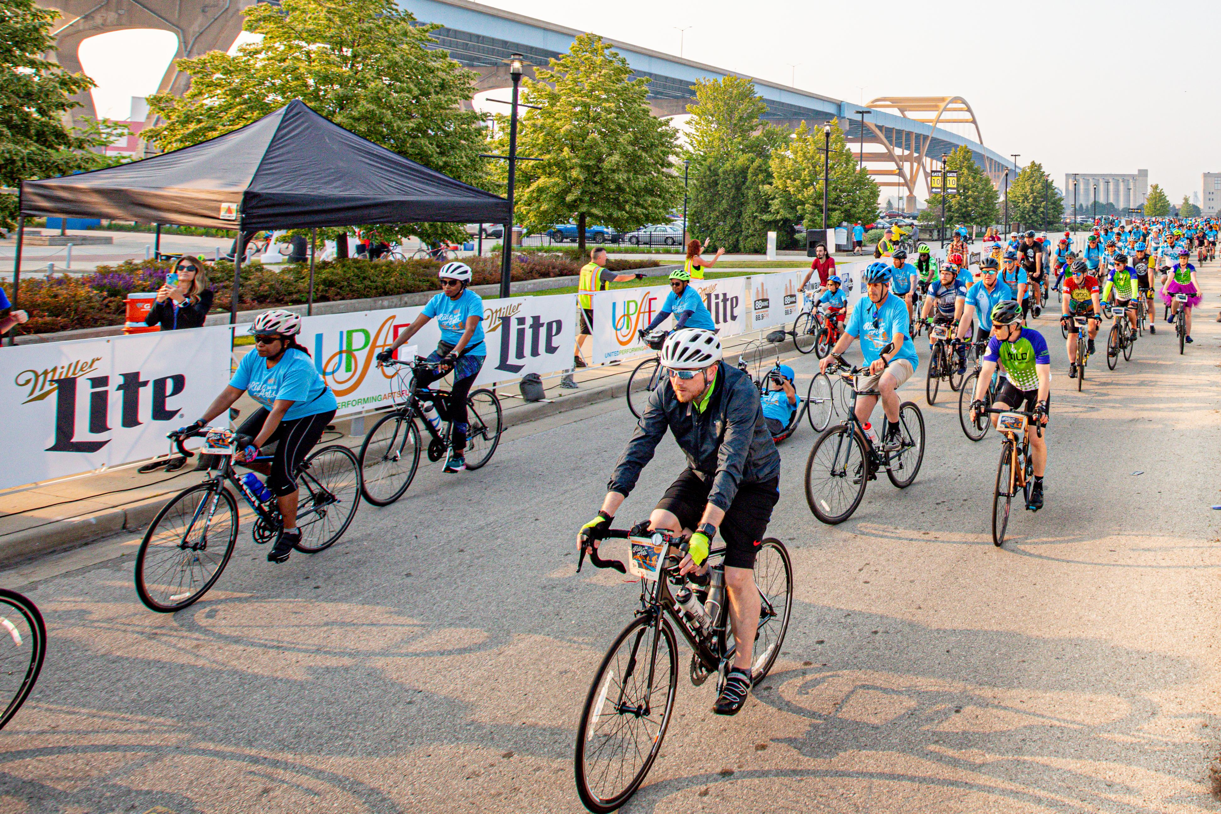
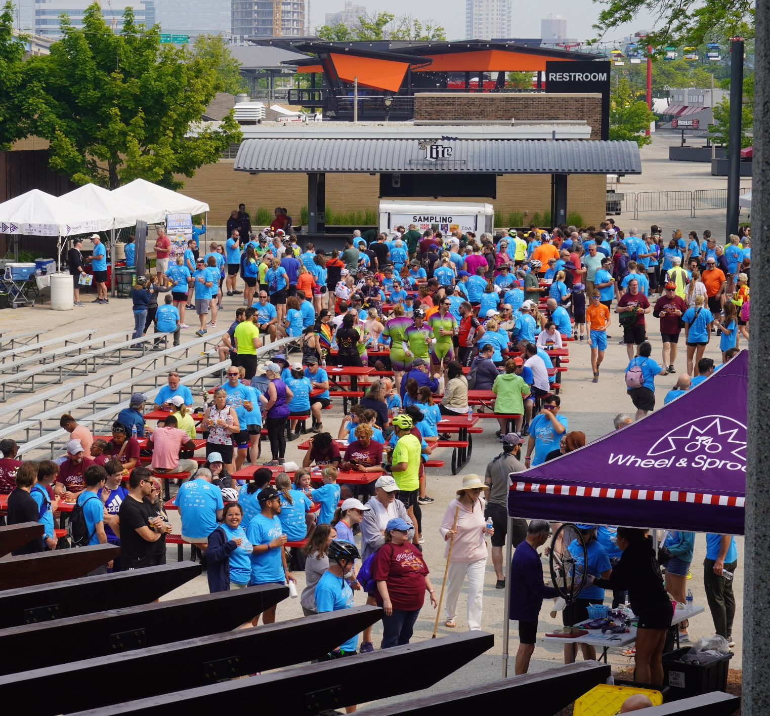
The UPAF Ride For The Arts, presented by Miller Lite is a signature community event celebrating Southeastern Wisconsin’s vibrant performing arts.
This annual fundraising event for the United Performing Arts Fund is an established Milwaukee tradition, engaging thousands of participants and hundreds of volunteers annually. Throughout it’s 44-year history the event has raised over $11 million.
Heading into its 45th anniversary, the 2025 Ride will return to the iconic Hoan Bridge, providing participants a one-of-a-kind ride that is suited for all ages and abilities followed by the post Ride celebration and UPAF Fest with live arts performances, kids’ activities, food, beverages and more!

Slide 18
Our 2025 Fundraising Goal:
$10.7 Million
Let’s increase by 16%!

Slide 19
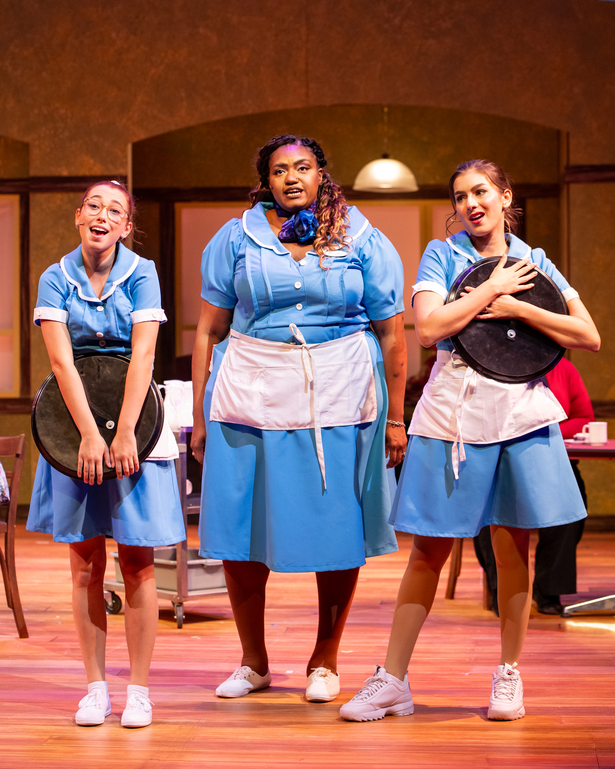
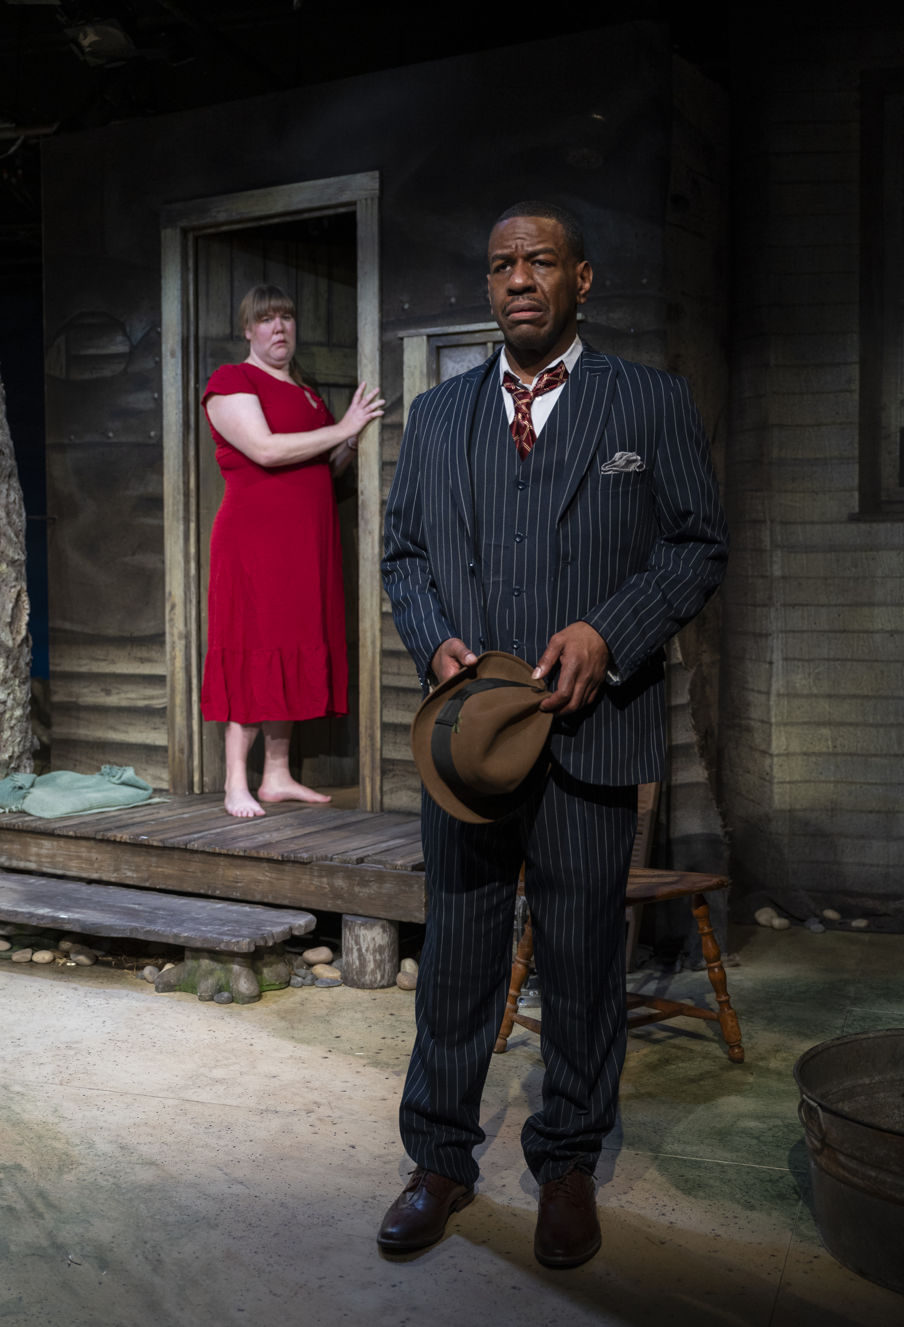
THANK YOU!!!

Slide 20
UPAF Workplace Giving Campaigns: Partnering with 100+ Local Companies & Counting!
Benefits of a UPAF Workplace Giving Campaign
Provides unique creative experiences that stimulate a positive company culture, foster employee well-being and inspire a healthy work environment
Encourages civic engagement & makes philanthropy easy
Promotes shared experiences that build social cohesion and cultivate empathy
Conveys your company’s mission and values both internally and externally
Improves employee retention and engagement
Nurtures creativity in the workforce, which amplifies important job skills and drives innovations that contribute to overall success
Customize your Campaign
Choose your campaign timing and length to work best for you
Bring the magic of music, dance and theater into your workplace with LIVE performers
UPAF staff will help you plan company events to encourage participation
You’ll have your own, customized giving site and access to tools and materials to make your campaign a success

